Slide 1
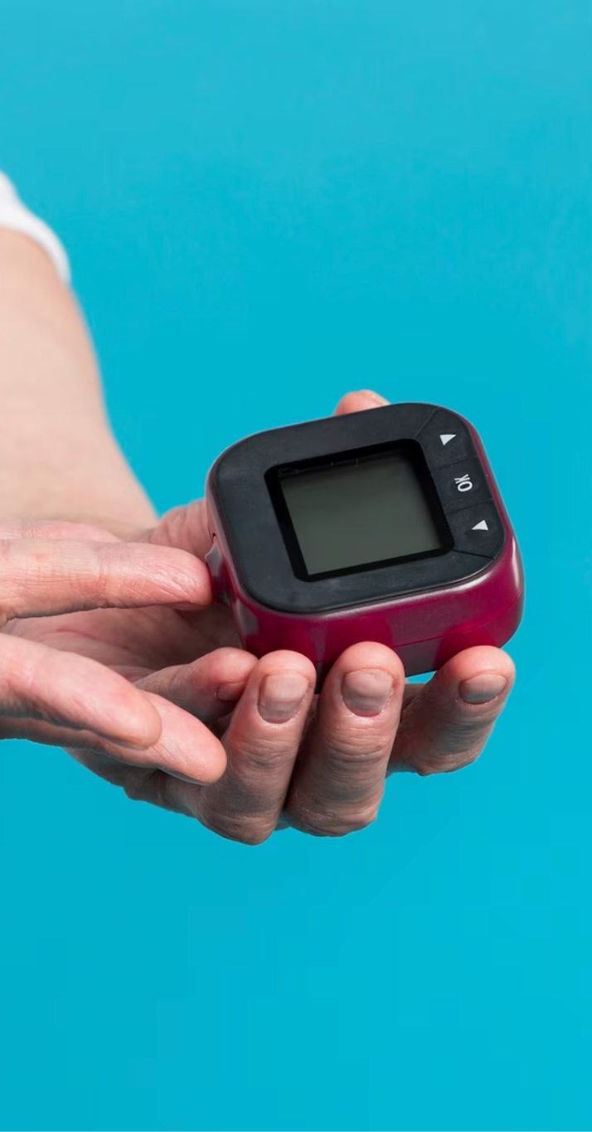
CardioCare
Health is Wealth………

Slide 2
Table of contents
02.
01.
03.
04.
05.
06.
Module
Project Explanation
Advantage of Proposed system
Data flow diagram
Technology Used
07.
Screenshots
08.
09.
Future Scope
Conclusion

Slide 3

AIM
The aim of the “CardioCare" project is to provide an interactive and educational platform where users can deals with quiz related to health topics through a series of questions and answers. The project seeks to promote health awareness , mainly focuses on two diseases Heart Attack and Diabetes.

Slide 4
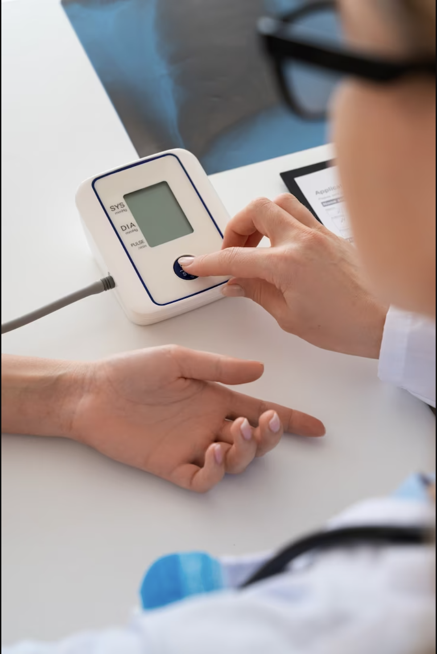
Project Explanation
The “CardioCare" project is an interactive application designed to educate and engage users on various health-related topics. The project involves creating a quiz-based platform where users can test their health aspects and understanding what the outcomes if people will not take care of his health. The application will present a series of multiple-choice questions related to health. Users will be able to select their answers from the given options. After submitting their responses, the application will provide immediate feedback, indicating what the result in the form of visualization of graphs if people ignore their health.

Slide 5

Modules
User module
Some features of the User Module include:
Registration: The User Module enables users to create an account by registering with their personal information.
Navigation: The User Module allows users to navigate through the project. It provides a clear interface for users to view the questions, select their options, and view their result .

Slide 6
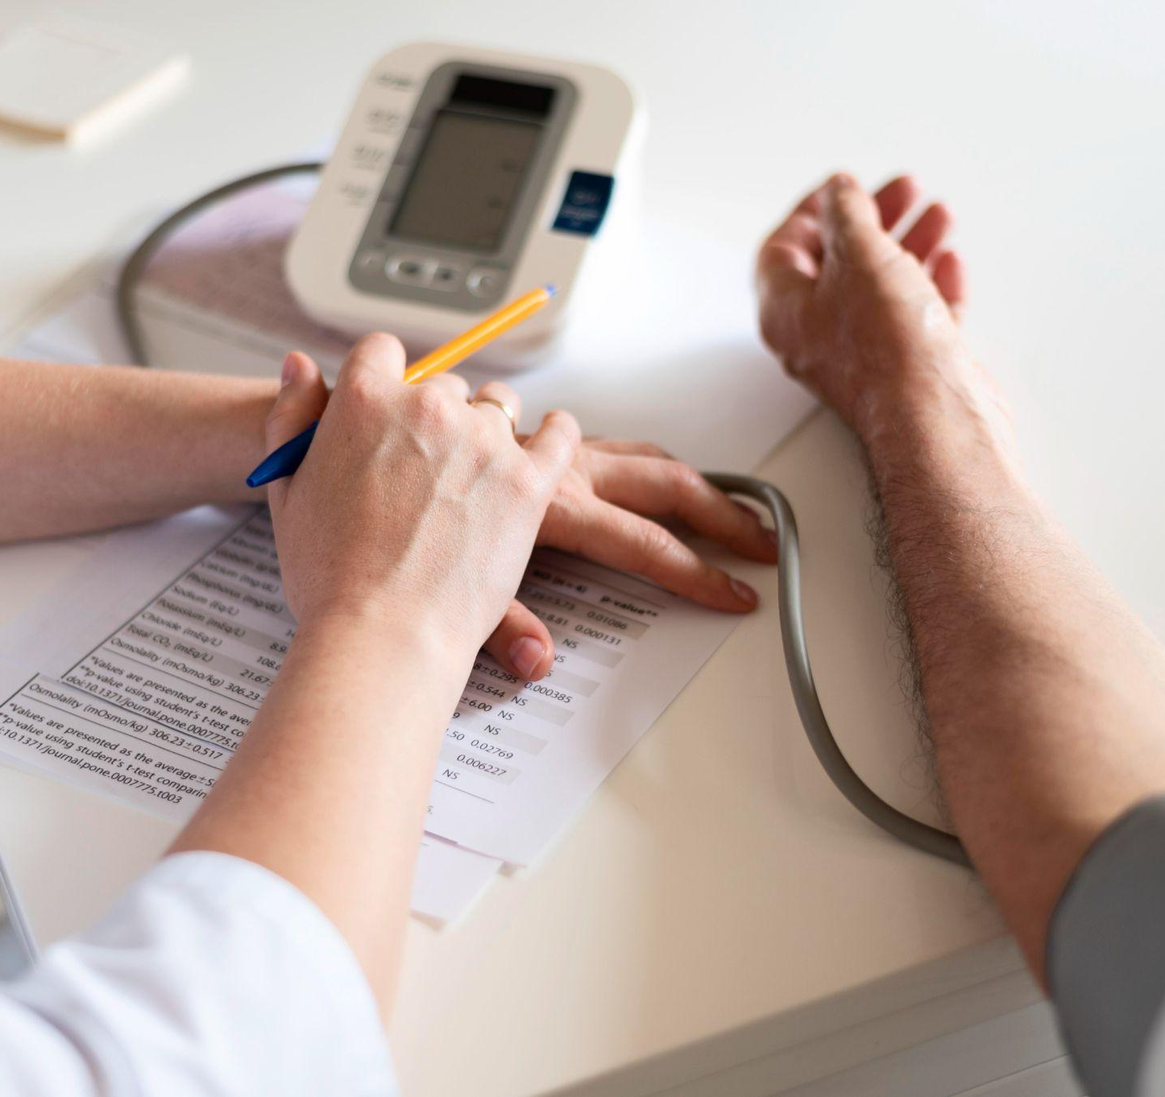

Result Display: The User can choose the question and click on following option by this right hand of every window shows the result in the form of graphs.

Slide 7


Advantages of poropsed system
The project provides a platform for users to expand their knowledge and understanding of various health-related topics.
It helps educate users about healthy habits, disease prevention, adopting fitness routines, and overall well-being. By increasing awareness, the project empowers individuals to take the good decisions about their health.
The project enables users to identify areas where people may needs improvement.
The project provides immediate result and possibly visualizations of the consequences of neglecting one's health can motivate users to actively work for their better results.

Slide 8
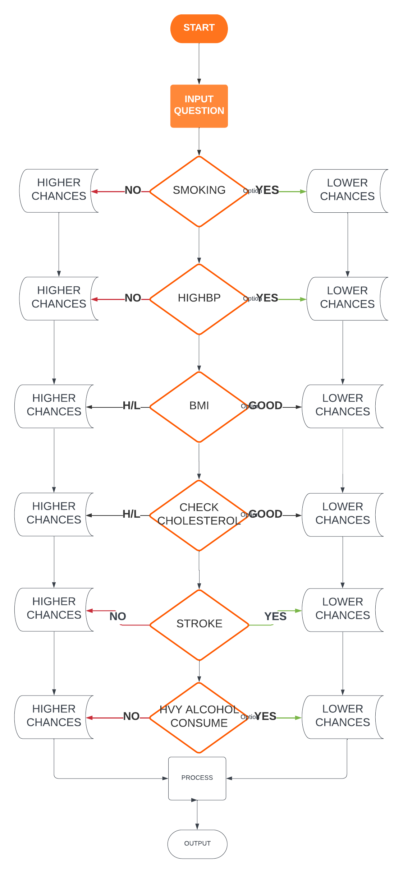
Data flow diagram

Slide 9


Technology Used
Front End Technology:-
Tkinter:
Tkinter is a widely used Python library for creating graphical user interfaces (GUIs). It provides a set of tools and widgets that allow developers to build interactive and visually appealing applications.
Python:
Python is a high-level, interpreted programming language known for its simplicity and readability. Python has gained immense popularity due to its versatility and extensive range of libraries and frameworks.
Google Colab:
It is a cloud-based platform provided by Google that offers a Jupyter Notebook environment for running and sharing Python code.

Slide 10
Technology Used
Back End Technology:-
Numpy:
It consist of core library for the numeric and scientific computing.
Pandas:
It stands for panel data and is the core libraries for data manipulation and data analysis.
Matplotlib:
It is a python libraries used for data visualization.
Seaborn:
Seaborn is a library for making statistical graphics in Python. It builds on top of matplotlib and integrates closely with pandas data structures.

Slide 11
Requirements
Hardware: i3 processor, 4GB RAM, 32-bit operating system.
Software: Python interpreter Visual Studio Code.

Slide 12
Screenshots

Slide 13
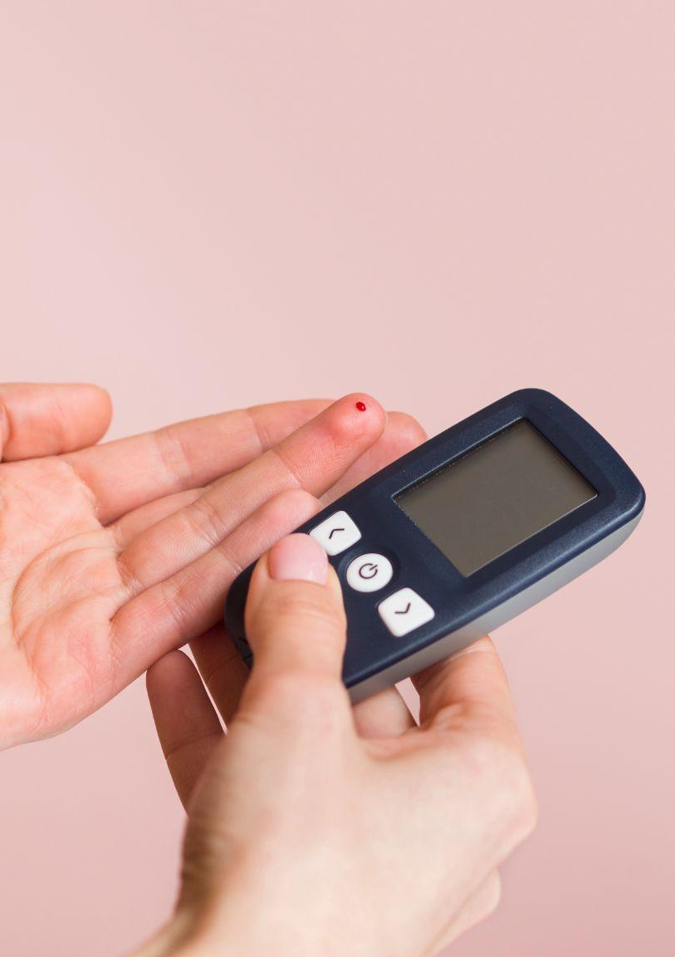
Conclusion
In conclusion, the “CardioCare" project is an interactive platform designed to promote health awareness. By providing a user-friendly quiz interface, immediate result, by visualizations .
The project aims to motivate individuals to prioritize their health and adopt healthier lifestyles. At the end “CardioCare" project strives to contribute to a society that is proactive about their health.

Slide 14
Future Scope
Enhanced Content: The project can incorporate a wider range of health topics and expand the question to cover various aspects of health.
Recommendations: By collecting user data and analyzing quiz performance, the project could offer personalized recommendations to each user's specific health needs.

Slide 15

Thank you for being patient and attentive

